Slide 1

Advanced Corporate Finance (LL4554V/LL5554V/LLJ5554V/LL6554V)
6. Risk & Return I: Portfolio Theory
Kenneth Khoo
kenneth.khoo@nus.edu.sg

Slide 2

Risk and return i: portfolio theory
Historic Returns and Risks
Diversification and Portfolio Risk
Optimal Portfolio Selection
Should Companies Diversify?

Slide 3
Risk and return i: portfolio theory
Market Risk is Measured by Beta
Estimating Beta
What Determines Beta?
CAPM, Betas, and Expected returns
Does CAPM Hold in the Real World?
Arbitrage Pricing Theory and Factor Models

Slide 4
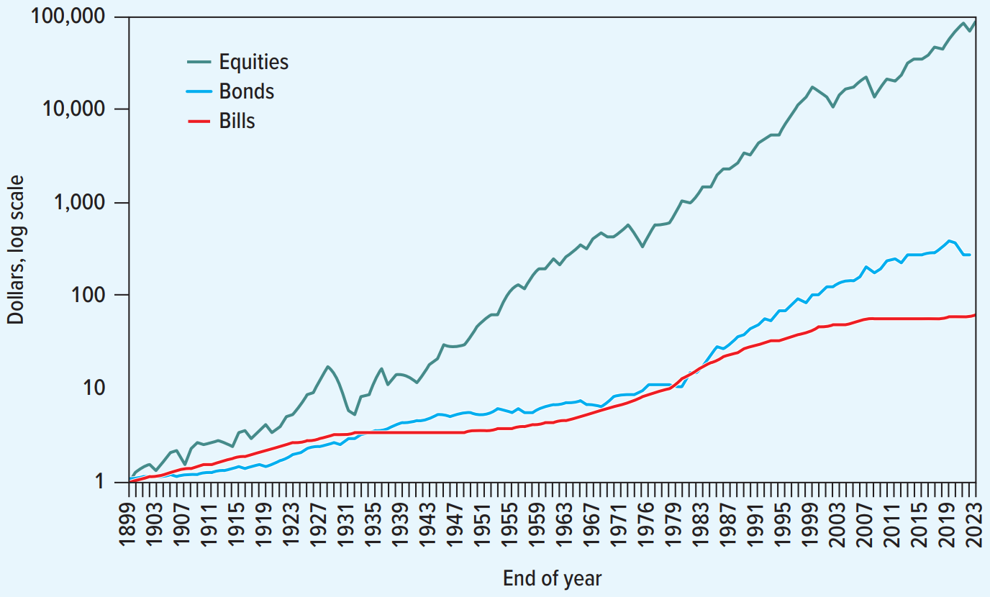
Historic returns and risks
Assume an investment of $1 at the start of 1900. How would it have grown by the end of 2023 in nominal terms, assuming reinvestment of all dividend and interest payments?
Source: E. Dimson, P. R. Marsh, and M. Staunton, Triumph of the Optimists: 101 Years of Global Investment Returns (Princeton, NJ: Princeton University Press, 2002), with updates provided by the authors.

Slide 5
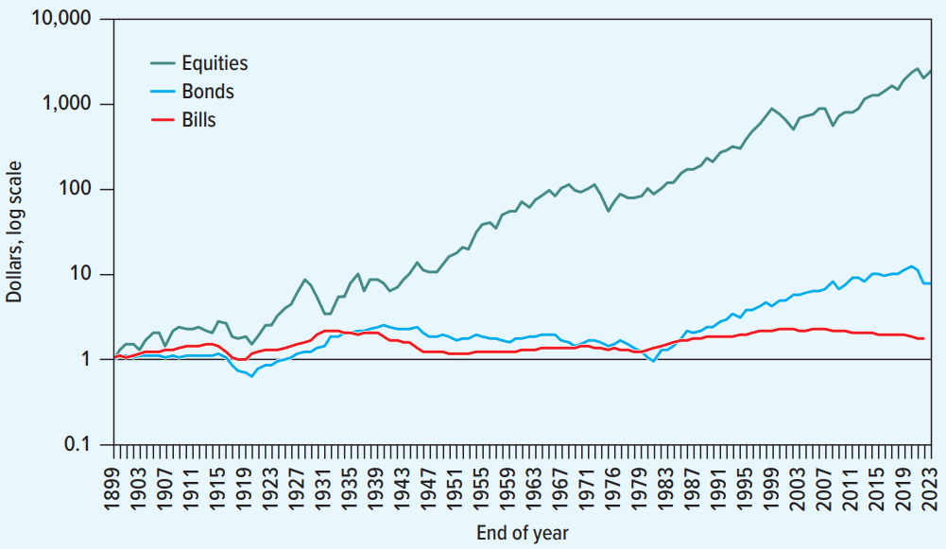
Historic returns and risks
Assume an investment of $1 at the start of 1900. How would it have grown by the end of 2023 in real terms (i.e., adjusting for inflation), assuming reinvestment of all dividend and interest payments?
Source: E. Dimson, P. R. Marsh, and M. Staunton, Triumph of the Optimists: 101 Years of Global Investment Returns (Princeton, NJ: Princeton University Press, 2002), with updates provided by the authors.

Slide 6
Historic returns and risks
Returns are not free; equity generates higher returns only in exchange for greater volatility.
The gap in returns between equities and risk-free bonds is often known as the “risk premium” for equities, or the “equity premium.”
However, this premium is historically so large that standard models of human risk aversion cannot explain it, a discrepancy known as the “equity premium puzzle.”
  Campbell and Cochrane (1999) propose that investors judge consumption against a “habit” standard of living, causing extreme risk aversion whenever a recession threatens to drop them below that level.
  Benartzi and Thaler (1995) argue that because investors check portfolios frequently, they require a high return to compensate for the psychological pain of observing short-term losses.

Slide 7
Historic returns and risks
Returns on U.S. Treasury bills, government bonds, and stocks data from 1900 to 2023
 | Nominal | Real | Average Risk Premium (Extra Return versus Treasury Bills)
Treasury bills | 3.4% | 0.6% | 0.0%
Government bonds | 5.0 | 2.2 | 1.6
Stocks | 11.5 | 8.4 | 8.1
Source: E. Dimson, P. R. Marsh, and M. Staunton, Triumph of the Optimists: 101 Years of Global Investment Returns (Princeton, NJ: Princeton University Press, 2002), with updates provided by the authors.

Slide 8
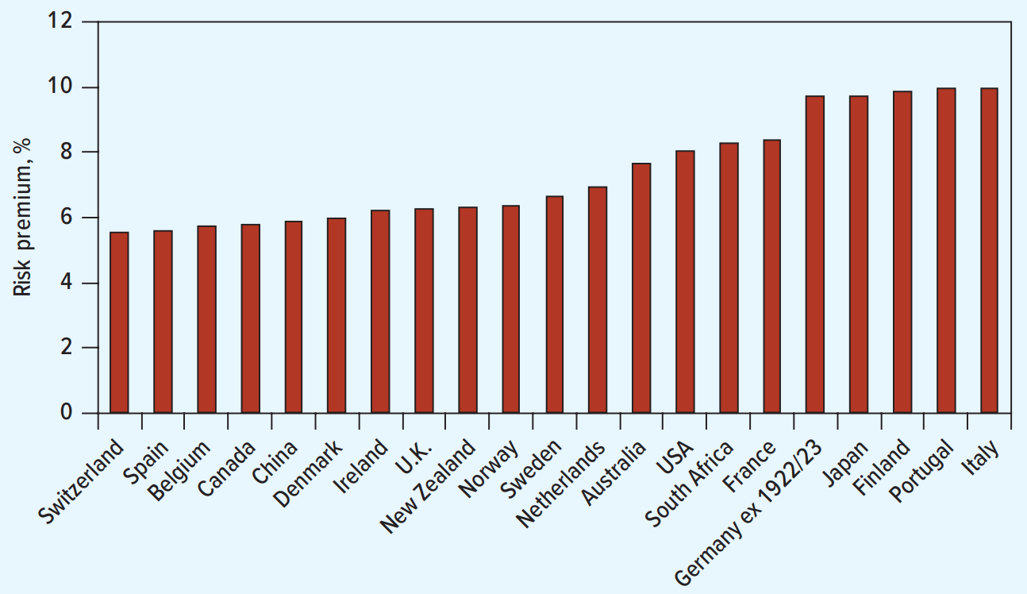
Historic returns and risks
Average market return premiums (nominal return on stocks minus nominal return on bills), 1900 to 2023.
Source: E. Dimson, P. R. Marsh, and M. Staunton, Triumph of the Optimists: 101 Years of Global Investment Returns (Princeton, NJ: Princeton University Press, 2002), with updates provided by the authors.

Slide 9
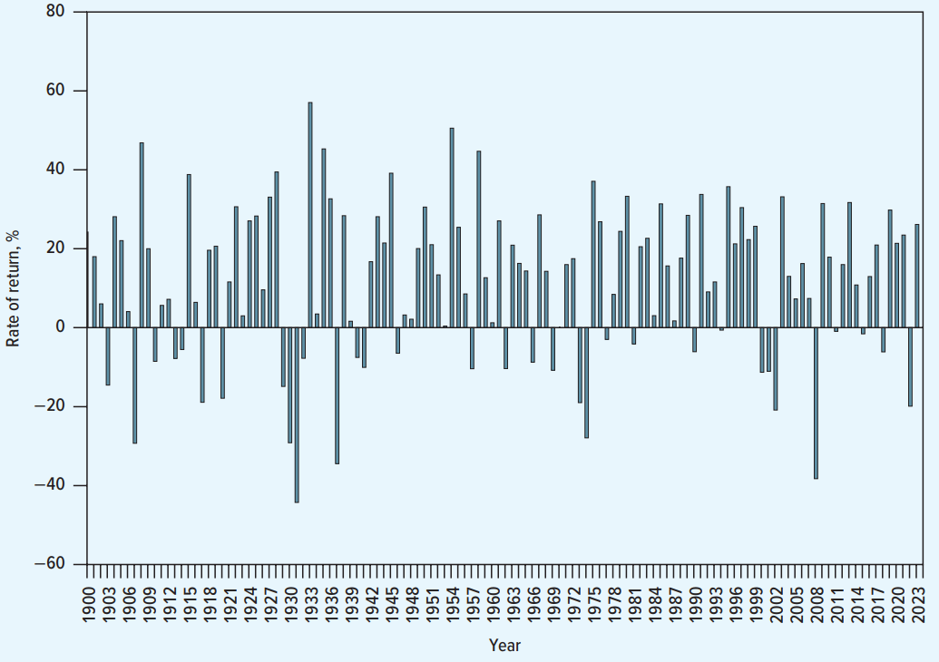
Historic returns and risks
The Stock Market has been a profitable but volatile investment.
Source: E. Dimson, P. R. Marsh, and M. Staunton, Triumph of the Optimists: 101 Years of Global Investment Returns (Princeton, NJ: Princeton University Press, 2002), with updates provided by the authors.

Slide 10
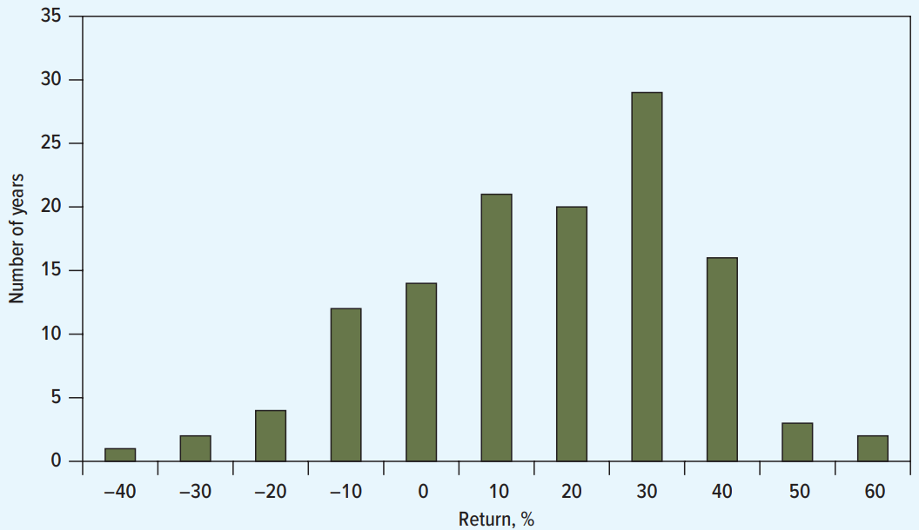
Historic returns and risks
The Stock Market has been a profitable but volatile investment.
Source: E. Dimson, P. R. Marsh, and M. Staunton, Triumph of the Optimists: 101 Years of Global Investment Returns (Princeton, NJ: Princeton University Press, 2002), with updates provided by the authors.

Slide 11
Historic returns and risks
To understand the extreme risk aversion proposed by Campbell, Cochrane, Benartzi, and Thaler, one must look at the historical severity of market crashes.
The “Dot-com” bubble burst in the early 2000s resulted in a prolonged decline, where the Nasdaq Composite lost nearly three-quarters of its value over two and a half years.
During the 2008 financial crisis, the market suffered a catastrophic drop, with the S&P 500 falling approximately 57% from its peak as the global financial system faced collapse.
Short-term shocks can be even more sudden; for instance, on Black Monday in 1987, the market plummeted 23% in a single day—roughly double the dramatic initial drop seen during the onset of the COVID-19 pandemic in March 2020.

Slide 12

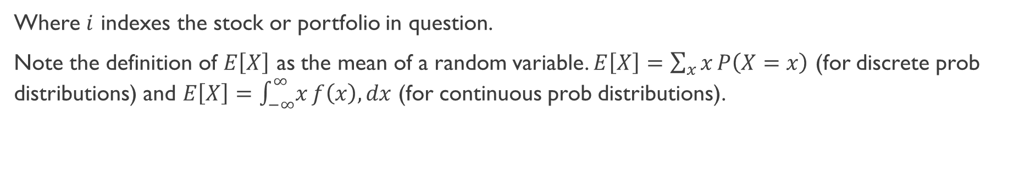
Diversification and portfolio risk
We begin with some terminology:
Variance
The variance of a stock’s return is the average squared difference between the actual return and the expected return.
Where $i$ indexes the stock or portfolio in question.
Note the definition of $E\left[X\right]$ as the mean of a random variable. $E\left[X\right]=\sum_{x}{x}P\left(X=x\right)$ (for discrete prob distributions) and $E\left[X\right]=\int_{−∞}^{∞}{x}f\left(x\right),dx$ (for continuous prob distributions).

Slide 13
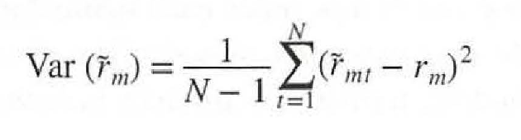
Diversification and portfolio risk
We begin with some terminology:
Variance
In practice, we usually measure the variance of a stock from observed data (TBD later) via the formula:
Where $N$ determines the number of observations (from $t=1… N$) over time, $\tilde{r_{mt}}$ is the market return in period $t$ [actual return], and $r_{m}$ is the mean of the values of $\tilde{r_{mt}}$ [mean return]. NB: $N−1$ is used to correct for the loss of a degree of freedom.

Slide 14
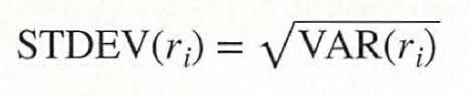
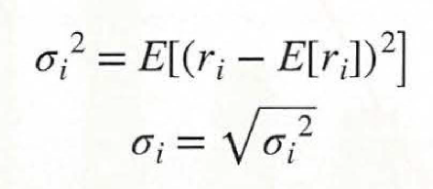
Diversification and portfolio risk
We begin with some terminology:
Standard Deviation
The standard deviation of a stock’s return is the square root of the stock’s variance.

Slide 15
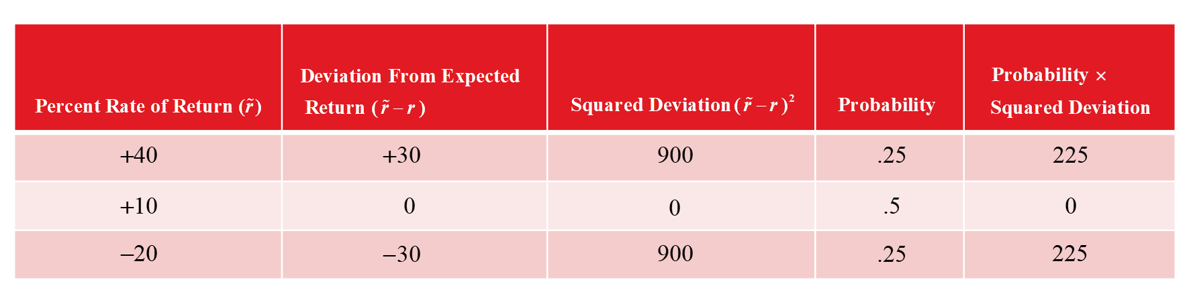
Diversification and portfolio risk
Assume an expected return of 10%.

Slide 16
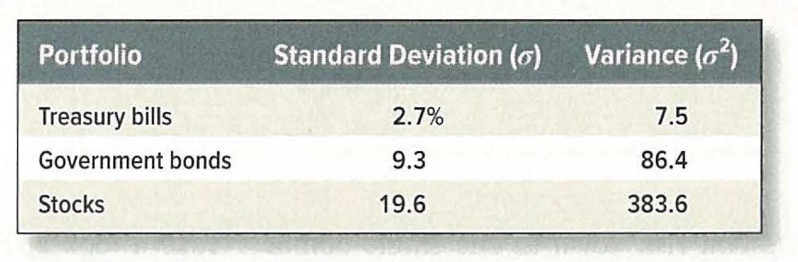
Diversification and portfolio risk
Investors can no longer assume that stocks are the only logical path forward.
  The superior returns associated with stocks are directly tied to their significant market volatility.
  The lower yields found in Treasury bills are compensated for by their status as a risk-free asset class.

Slide 17
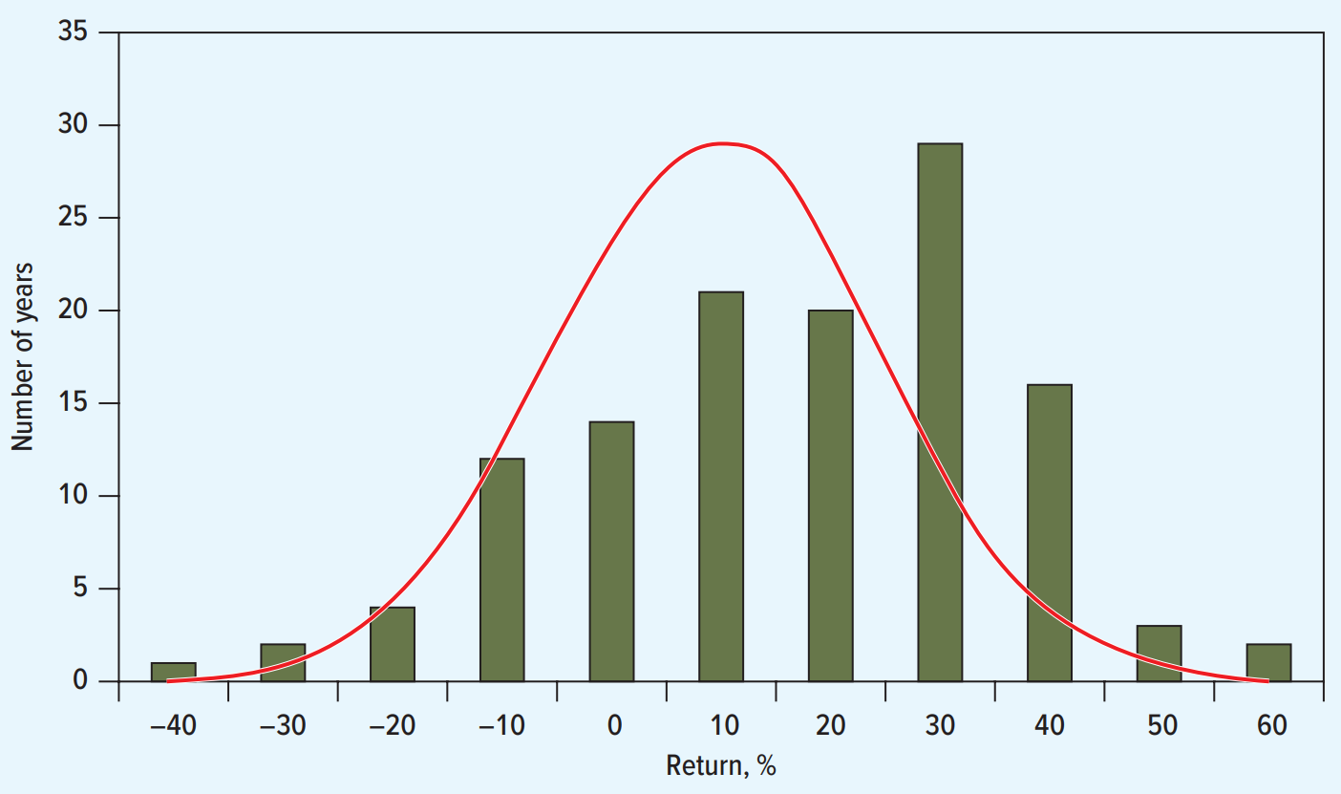
Diversification and portfolio risk
NB: Long-term returns deviate from the normal distribution typically observed in short-term returns.
Notice how the mean is not centered around 0. Implications?
Source: E. Dimson, P. R. Marsh, and M. Staunton, Triumph of the Optimists: 101 Years of Global Investment Returns (Princeton, NJ: Princeton University Press, 2002), with updates provided by the authors.

Slide 18
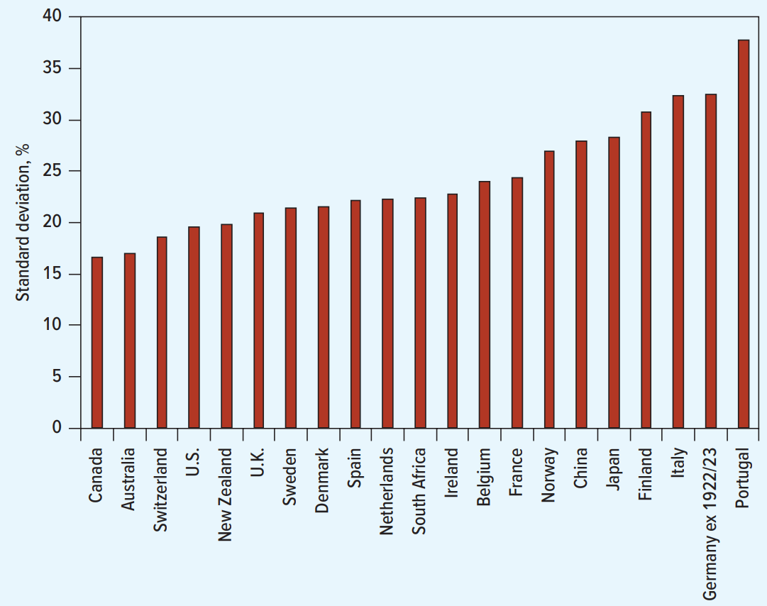
Diversification and portfolio risk
The risk (standard deviation of annual returns) of markets around the world, 1900 to 2023.
Source: E. Dimson, P. R. Marsh, and M. Staunton, Triumph of the Optimists: 101 Years of Global Investment Returns (Princeton, NJ: Princeton University Press, 2002), with updates provided by the authors.

Slide 19
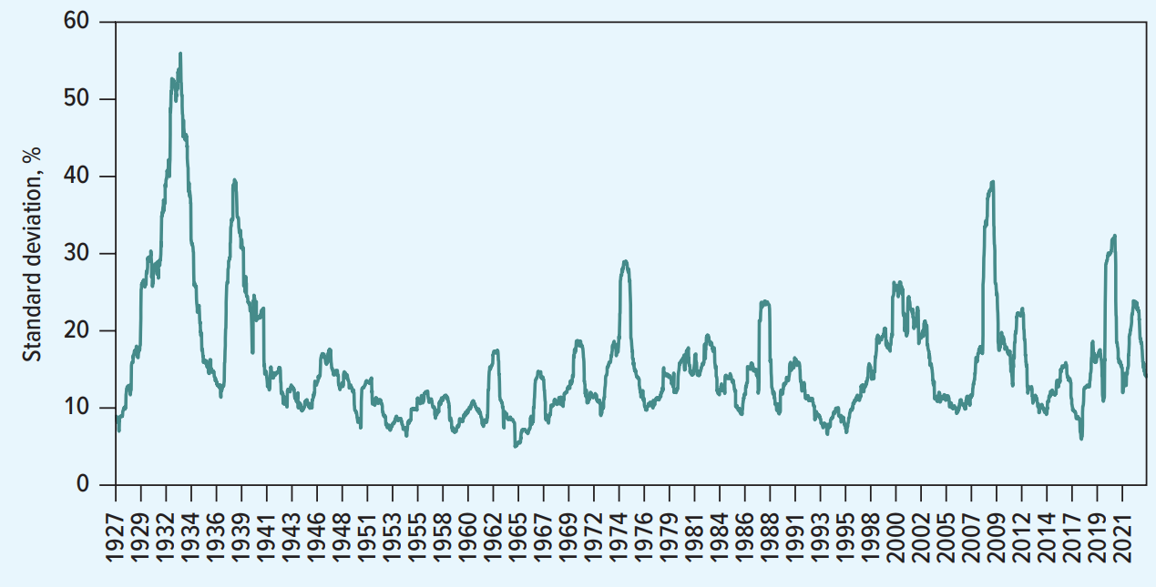
Diversification and portfolio risk
Annualized standard deviation of the preceding 52 weekly market returns, June 1927 to January 2024.
Source: E. Dimson, P. R. Marsh, and M. Staunton, Triumph of the Optimists: 101 Years of Global Investment Returns (Princeton, NJ: Princeton University Press, 2002), with updates provided by the authors.

Slide 20
Diversification and portfolio risk
Notice that we have computed future expected returns based on historical returns.
In practice, estimating future returns is a blend of science and art, requiring investors to bridge the gap between the mathematically precise historical record and the uncertain forward-looking reality.
The “Stable Risk Premium Principle” suggests that while total market returns fluctuate significantly with interest rates, the extra compensation investors demand for holding risky assets remains relatively constant over time.
Consequently, the most robust method for forecasting is to add the long-term historical average risk premium to the current risk-free rate, rather than simply projecting past total returns into the future.
Note that blind reliance on history is imperfect because structural shifts—such as the rise of easy diversification through ETFs or changes in global economic stability—may have permanently altered the risk premium investors require today compared to previous eras.

Slide 21
Diversification and portfolio risk
Diversification: Strategy designed to reduce risk by spreading the portfolio across many investments, ensuring that the poor performance of a single asset does not drastically impact the total value.
Specific Risk: Risk factors affecting only that firm, such as management scandals, labor strikes, or product recalls, which can be eliminated by holding a variety of assets. Also called “diversifiable risk” or “idiosyncratic risk”.
Market Risk: Economy-wide sources of risk that affect the overall stock market, including inflation, interest rate hikes, and recessions, which cannot be eliminated through diversification. Also called “systematic risk”.

Slide 22
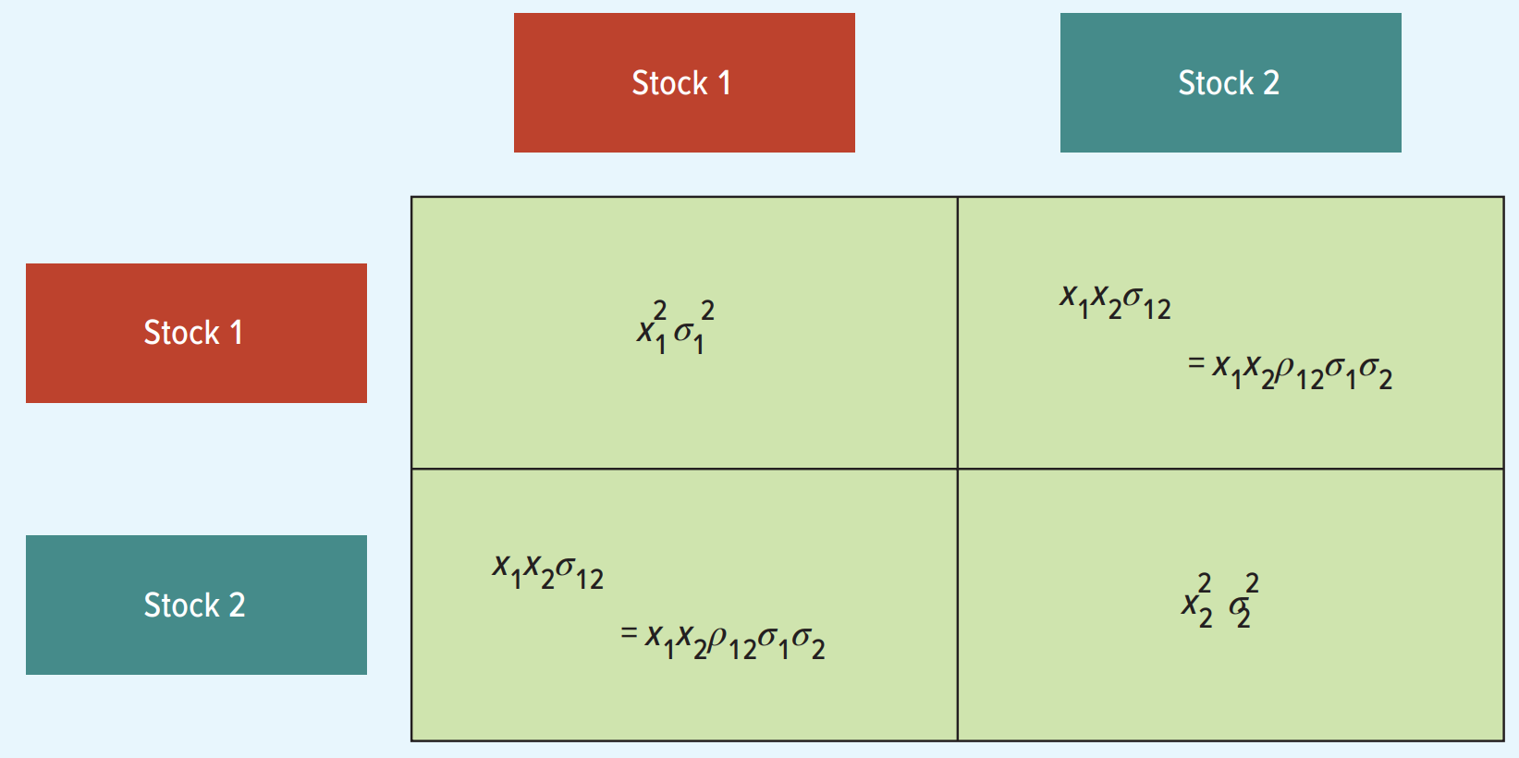
Diversification and portfolio risk

Slide 23
Diversification and portfolio risk
Example
Suppose you invest 60% of your portfolio in Southwest Airlines and the remainder in Amazon. The expected dollar return on your Southwest investment is 15.0% and on Amazon is 10.0%. The expected return on your portfolio is:

Slide 24
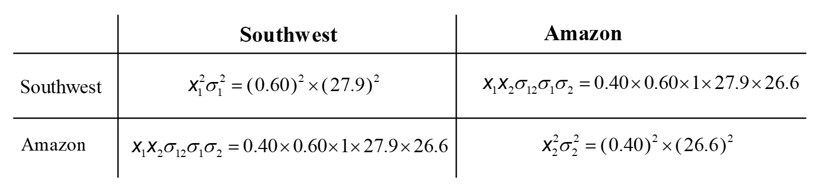
Diversification and portfolio risk
Example
Suppose you invest 60% of your portfolio in Southwest Airlines and the remainder in Amazon. The expected dollar return on your Southwest investment is 15.0% and on Amazon is 10.0%. The standard deviation of returns was 26.6% for Amazon and 27.9% for Southwest Airlines. Assume a correlation coefficient of 1.0 and calculate the portfolio variance and standard deviation.

Slide 25
Diversification and portfolio risk
Example
Suppose you invest 60% of your portfolio in Southwest Airlines and the remainder in Amazon. The expected dollar return on your Southwest investment is 15.0% and on Amazon is 10.0%. The standard deviation of returns was 26.6% for Amazon and 27.9% for Southwest Airlines. Assume a correlation coefficient of 0.26 and calculate the portfolio variance and standard deviation.

Slide 26
Diversification and portfolio risk
Example
Suppose you invest 60% of your portfolio in Southwest Airlines and the remainder in Amazon. The expected dollar return on your Southwest investment is 15.0% and on Amazon is 10.0%. The standard deviation of returns was 26.6% for Amazon and 27.9% for Southwest Airlines. Assume a correlation coefficient of −1 and calculate the portfolio variance and standard deviation.

Slide 27
Diversification and portfolio risk
More generally, for any two securities labeled “1” and “2”, we have:
Where $x_{1}$ and $x_{2}$ are the respective portfolio weights of securities 1 and 2, $r_{1}$ and $r_{2}$ are the expected returns for securities 1 and 2, $σ_{1}^{2}$ and $σ_{2}^{2}$ are the variances for securities 1 and 2, and $ρ_{12}$ is the correlation coefficient for the two securities.

Slide 28
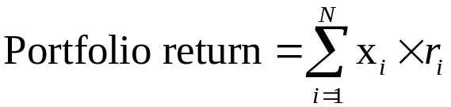
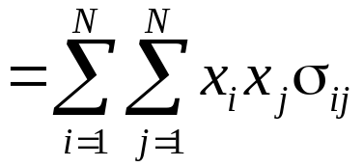
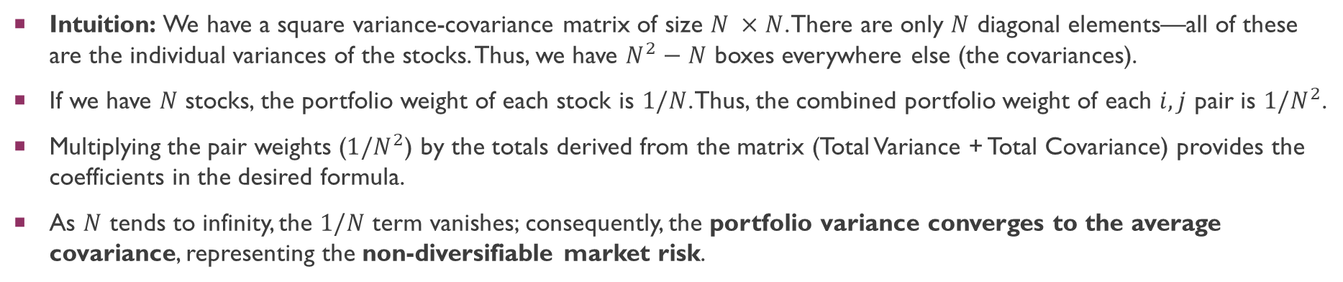
Diversification and portfolio risk
We can extend this to securities $i$ and $j$:
Intuition: We have a square variance-covariance matrix of size $N ×N$. There are only $N$ diagonal elements—all of these are the individual variances of the stocks. Thus, we have $N^{2}−N$ boxes everywhere else (the covariances).
If we have $N$ stocks, the portfolio weight of each stock is $1/N$. Thus, the combined portfolio weight of each $i,j$ pair is $1/N^{2}$.
Multiplying the pair weights ($1/N^{2}$) by the totals derived from the matrix (Total Variance + Total Covariance) provides the coefficients in the desired formula.
As $N$ tends to infinity, the $1/N$ term vanishes; consequently, the portfolio variance converges to the average covariance, representing the non-diversifiable market risk.

Slide 29
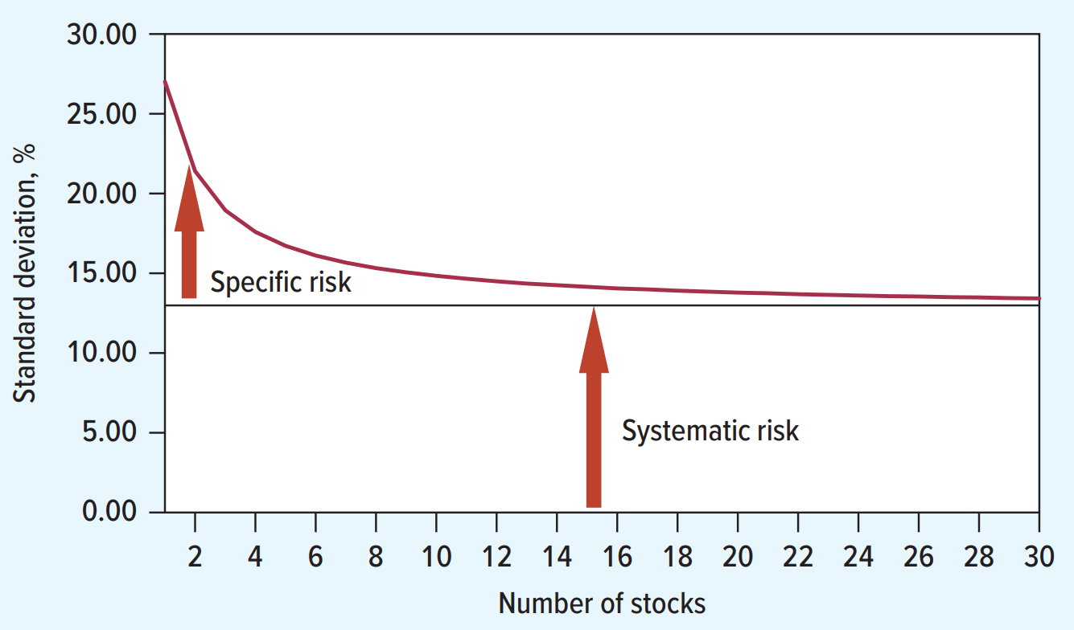
Diversification and portfolio risk
Average risk (standard deviation) of portfolios containing different numbers of stocks.
Source: E. Dimson, P. R. Marsh, and M. Staunton, Triumph of the Optimists: 101 Years of Global Investment Returns (Princeton, NJ: Princeton University Press, 2002), with updates provided by the authors.

Slide 30
Optimal Portfolio selection
Combining stocks into a diversified portfolio reduces the overall standard deviation to levels significantly lower than a simple weighted average of the individual component risks would suggest.
This mathematical advantage is driven by correlation coefficients that are less than perfect, allowing the price movements of different assets to offset one another.
The various combinations of assets that successfully minimize this risk constitute a set of efficient portfolios, which are defined as portfolios that offer the highest expected return for a specific level of risk.
These optimal combinations form a curve known as the efficient frontier, where every point represents an efficient portfolio that maximizes returns for that specific tolerance of risk.

Slide 31
Optimal portfolio selection
Three Efficient Portfolios—Percentages Allocated to Each Stock (%).
 | Expected Return | Standard Deviation | A | B | T
Johnson & Johnson | 6 | 17.3 |  | 21 | 39
Nucor | 6.5 | 43.3 |  | 0 | 0
Home Depot | 5 | 24.2 |  | 1 | 0
Citigroup | 10 | 37.5 | 100 | 0 | 6
Apple | 8 | 32.1 |  | 0 | 2
Walmart | 6.8 | 19.8 |  | 21 | 36
Goldman Sachs | 5.3 | 32.2 |  | 0 | 0
Microsoft | 5.5 | 21.6 |  | 17 | 9
Coca-Cola | 4.4 | 18.6 |  | 29 | 8
Southwest Airlines | 4.8 | 36.8 |  | 1 | 0
Expected portfolio return |  |  | 10 | 5.6 | 6.4
Portfolio standard deviation |  |  | 37.5 | 14.5 | 15.4
Note: Standard deviations and the correlations between stock returns were estimated from monthly returns, January 2018–December 2022. Expected returns are derived in Section 8.2. Efficient portfolios are calculated assuming that short sales are prohibited.

Slide 32
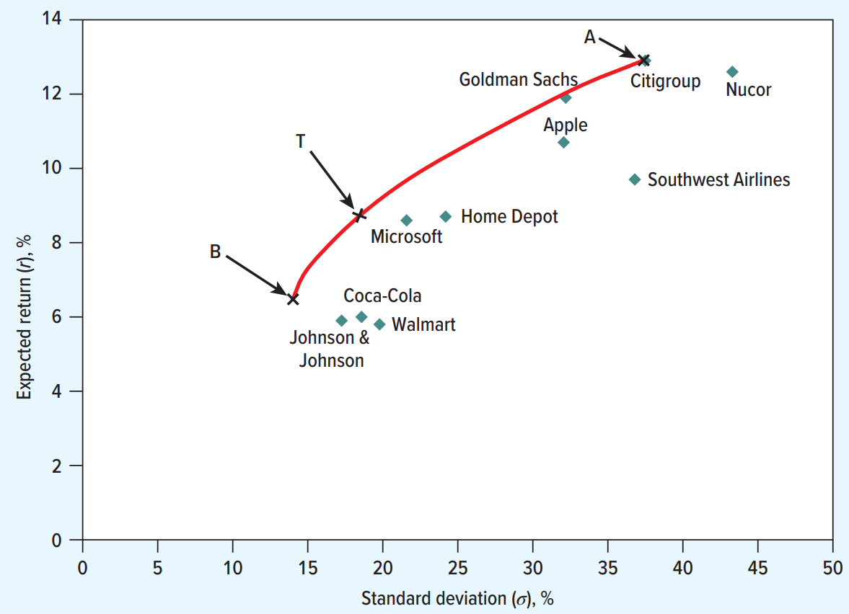
Optimal portfolio selection
Each dot shows the expected return and standard deviation of the stocks described in the previous table. The efficient portfolios are denoted with labels A, B, and T.

Slide 33
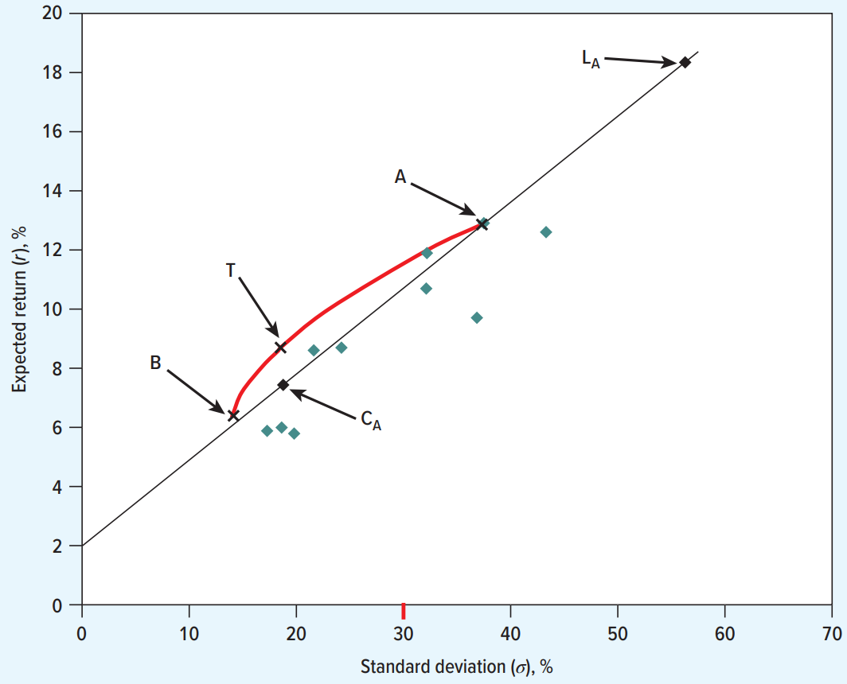
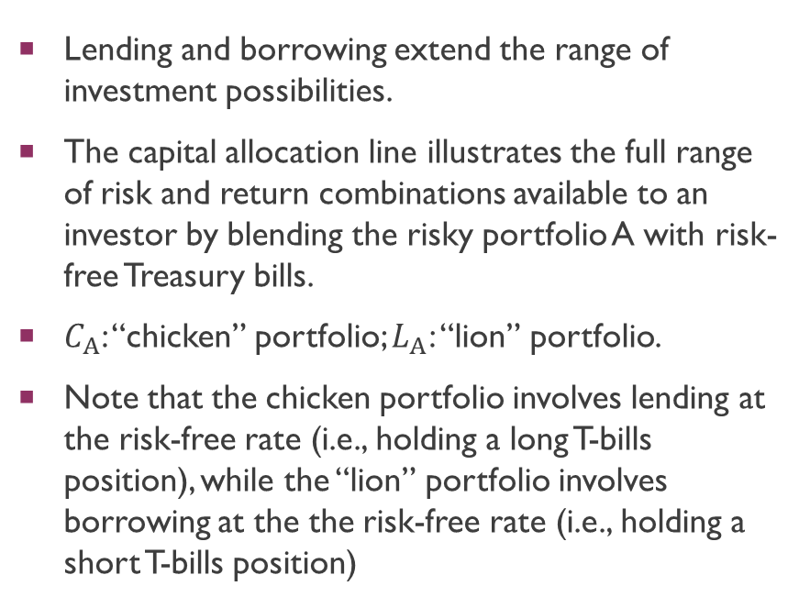
Optimal portfolio selection
Lending and borrowing extend the range of investment possibilities.
The capital allocation line illustrates the full range of risk and return combinations available to an investor by blending the risky portfolio A with risk-free Treasury bills.
$C_{A}$: “chicken” portfolio; $L_{A}$: “lion” portfolio.
Note that the chicken portfolio involves lending at the risk-free rate (i.e., holding a long T-bills position), while the “lion” portfolio involves borrowing at the the risk-free rate (i.e., holding a short T-bills position)

Slide 34
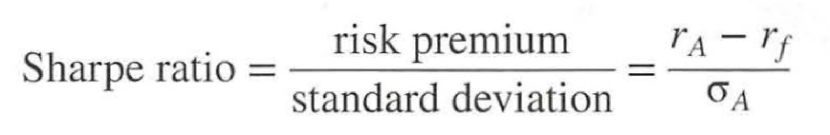
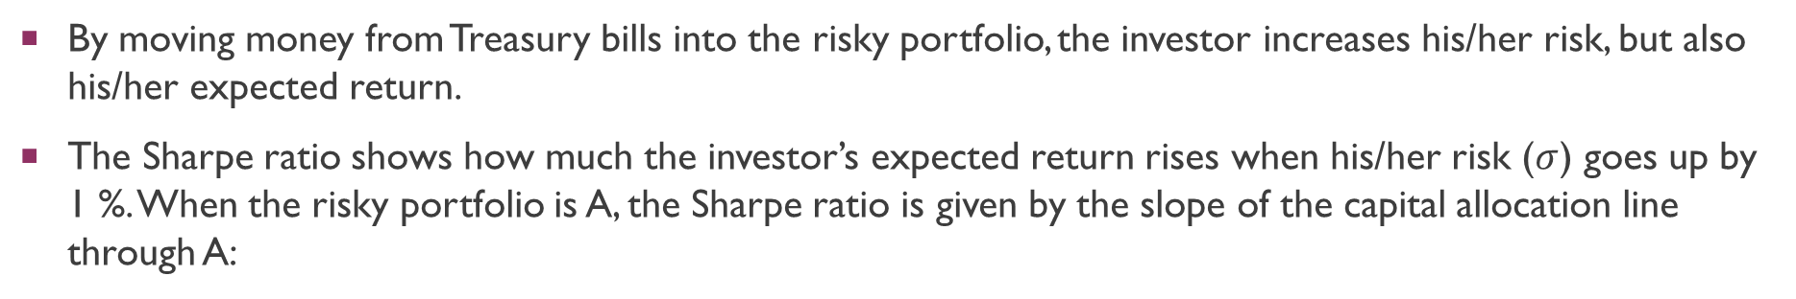
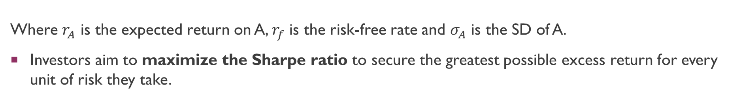
Optimal Portfolio selection
By moving money from Treasury bills into the risky portfolio, the investor increases his/her risk, but also his/her expected return.
The Sharpe ratio shows how much the investor’s expected return rises when his/her risk ($σ$) goes up by 1 %. When the risky portfolio is A, the Sharpe ratio is given by the slope of the capital allocation line through A:
Where $r_{A}$ is the expected return on A, $r_{f}$ is the risk-free rate and $σ_{A}$ is the SD of A.
Investors aim to maximize the Sharpe ratio to secure the greatest possible excess return for every unit of risk they take.

Slide 35
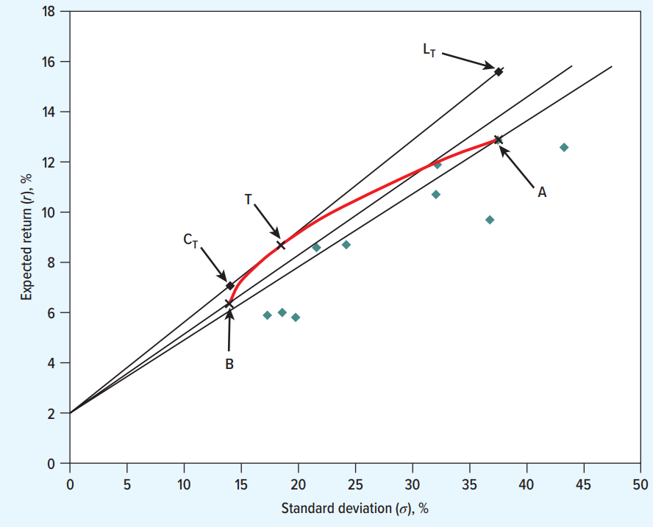
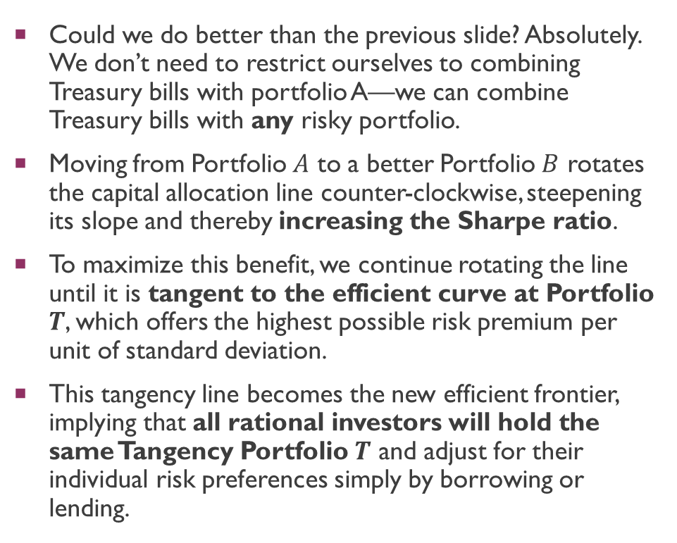
Optimal portfolio selection
Could we do better than the previous slide? Absolutely. We don’t need to restrict ourselves to combining Treasury bills with portfolio A—we can combine Treasury bills with any risky portfolio.
Moving from Portfolio $A$ to a better Portfolio $B$ rotates the capital allocation line counter-clockwise, steepening its slope and thereby increasing the Sharpe ratio.
To maximize this benefit, we continue rotating the line until it is tangent to the efficient curve at Portfolio $T$, which offers the highest possible risk premium per unit of standard deviation.
This tangency line becomes the new efficient frontier, implying that all rational investors will hold the same Tangency Portfolio $T$ and adjust for their individual risk preferences simply by borrowing or lending.

Slide 36
Optimal Portfolio selection
This analysis is a very powerful result. It leads to the following principle:
  The Common Portfolio Principle: If all investors have the same information and form the same expectations, all should hold the same portfolio of stocks.
How can all investors be willing to hold exactly the same portfolio of stocks, when they may have quite different risk appetites?
  The answer is that they satisfy their preferences through choosing different amounts of borrowing and lending, not through choosing different stocks.

Slide 37
Optimal Portfolio selection
What is portfolio T? If all investors hold the same stocks, and all stocks are held, this means that all investors should hold the market portfolio.
  The market portfolio is the portfolio of all traded stocks in the economy, where the weights correspond to the fraction of the overall market that each stock represents. For example, if Apple comprises 3% of the value of all traded stocks, then Apple will be 3% of the market portfolio.
As a result, every investor holds only two funds, a result known as the two-fund separation theorem:
  The Two-Fund Separation Theorem: Every investor holds two investments: the market portfolio T and the risk-free asset.

Slide 38
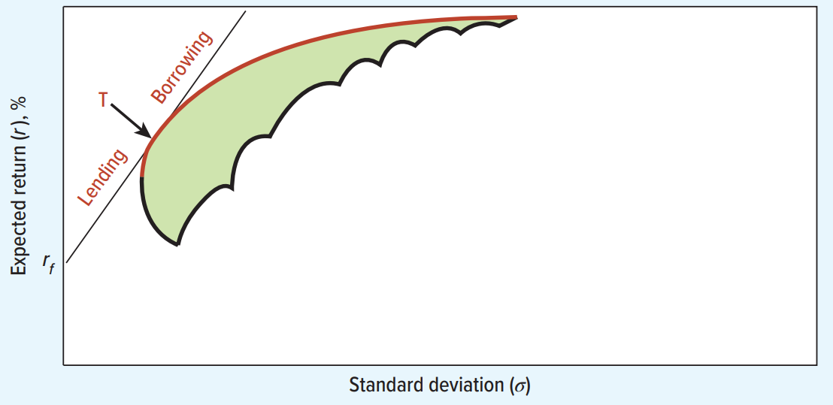
Optimal portfolio selection
The two fund separation theorem and the efficient frontier. All investors hold a combination of the risk free asset and portfolio T.

Slide 39
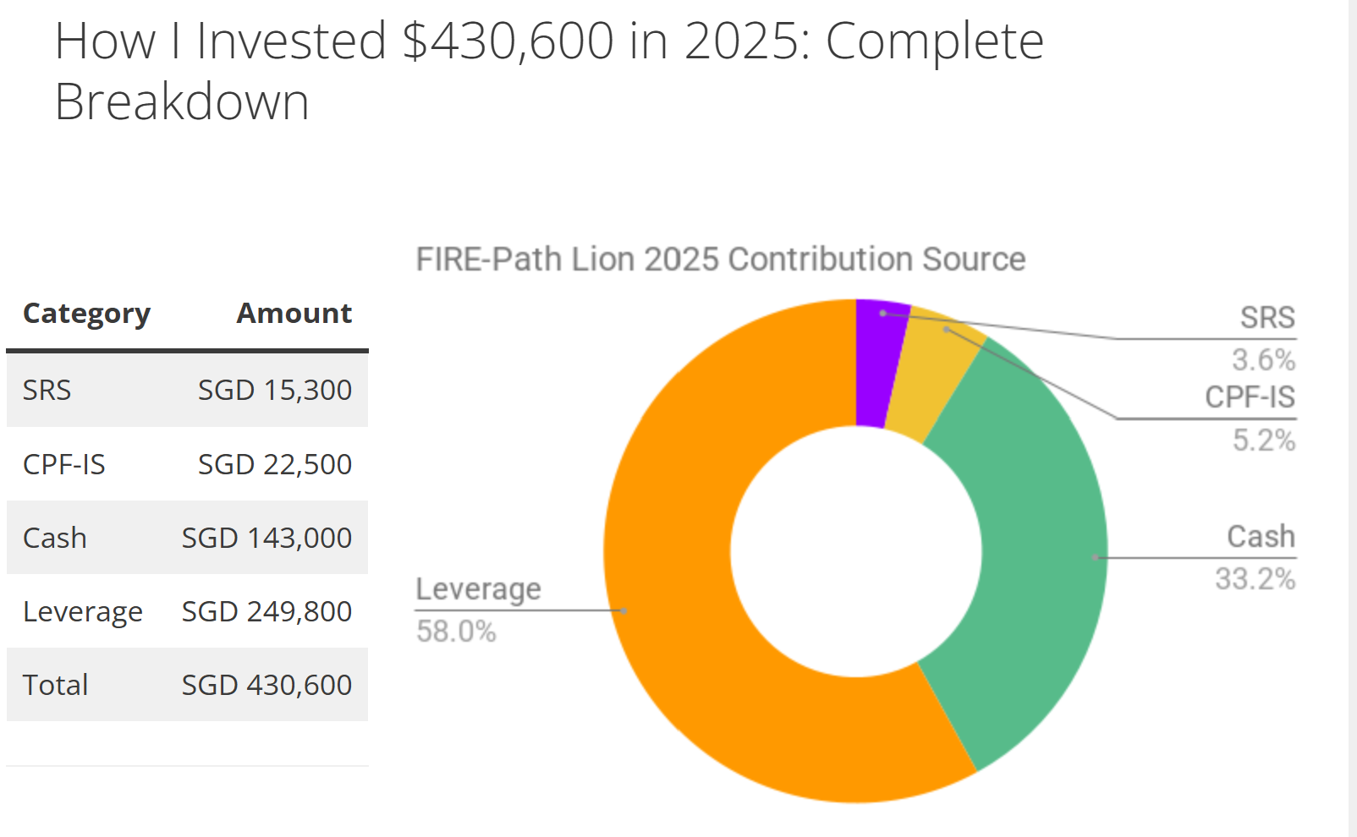
Optimal portfolio selection
Real life application of leverage + “Portfolio T”: https://www.firepathlion.com/my-fire-path-2025-turning-40-from-0-to-4m-in-10-years/

Slide 40
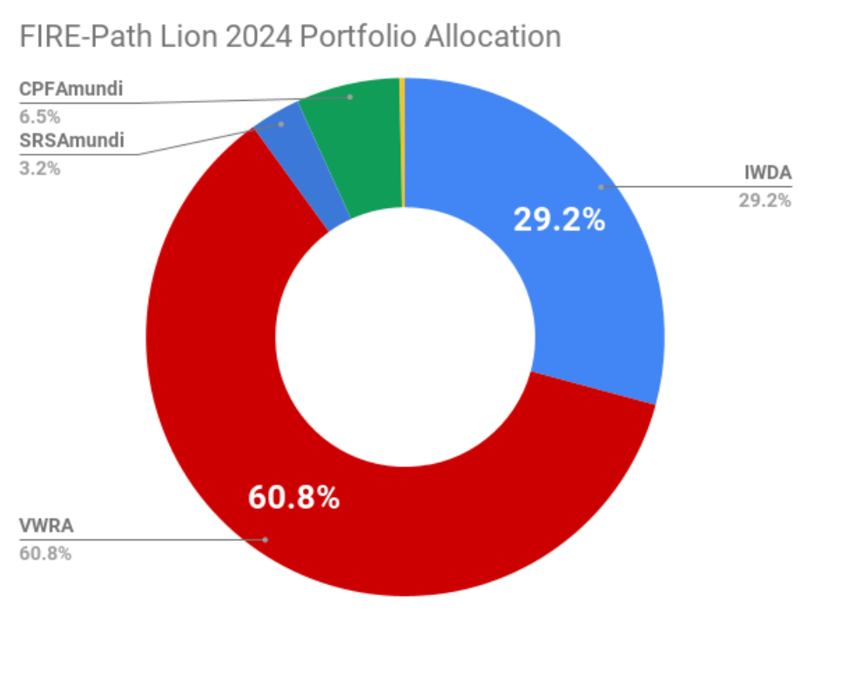
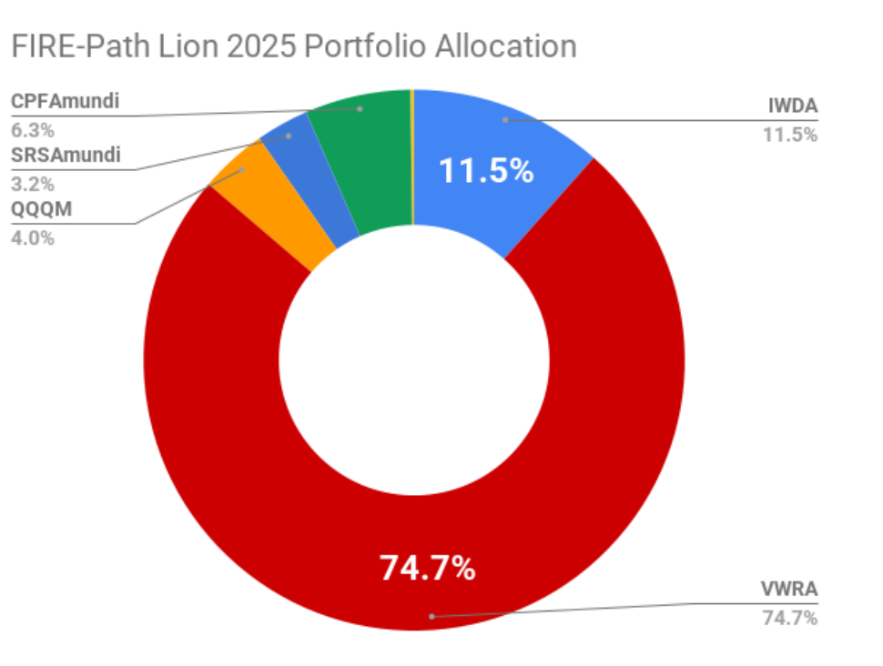
Optimal portfolio selection
Real life application of leverage + “Portfolio T”: https://www.firepathlion.com/my-fire-path-2025-turning-40-from-0-to-4m-in-10-years/
NB: Note that only QQQM (yellow region) is not “the market portfolio” (with caveats).

Slide 41
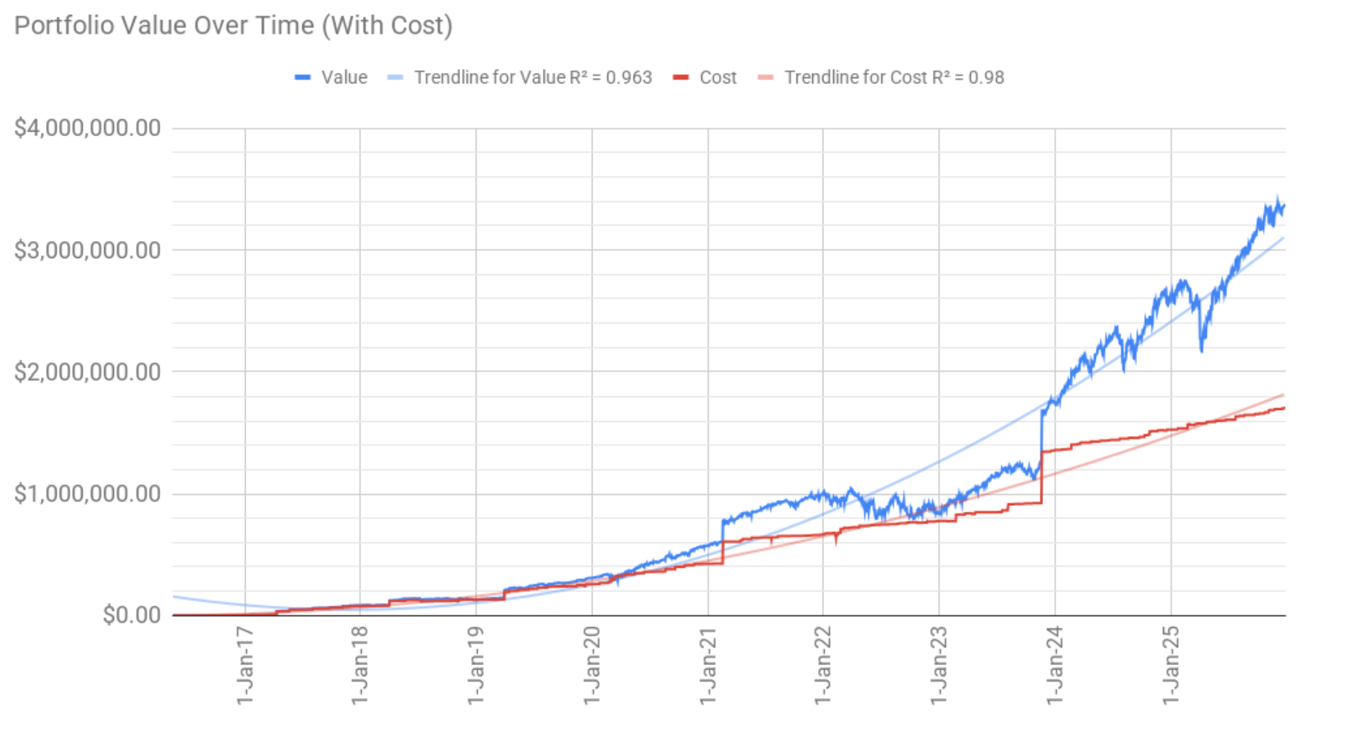
Optimal portfolio selection
“Lion” portfolios do very well in a “bullish” market (and of course, poorly in a “bearish” market).

Slide 42

Should companies diversify?
The fact that diversification is good for investors does not mean that companies should pursue it.
  This is because investors can diversify themselves.
  Because investors can diversify on their own account, they won’t pay any extra for a firm that is diversified.
This implies value additivity (NB: recall our last slide deck):

Slide 43
Market Risk Is Measured by Beta
Market Portfolio: Portfolio of all assets in the economy. In practice, a broad stock market index such as the “FTSE All-World Index” or the “MSCI World Index” is used to represent the market.
  Theoretically, the “market portfolio” we spoke of earlier must contain all risky assets in the global economy, held in proportion to their total market value.
  Beyond just public equities, a true market portfolio would theoretically include other assets like bonds, real estate, private equity, and commodities.
  Unfortunately, since it is impossible to construct a portfolio that actually holds every risky asset in the world (especially private businesses), financial professionals often use broad equity indices like the FTSE All-World or MSCI ACWI as the closest investable approximation.
  Thus, our approximation of the market portfolio implies a lower Sharpe Ratio. In particular, relying solely on equities hinges performance entirely on economic growth, forfeiting the protection against recession and inflation provided by bonds and real assets.

Slide 44
Market Risk Is Measured by Beta
Doeswijk, Lam, and Swinkels (2020) compare the theoretical “Market Portfolio” against a 100% Global Equity portfolio over nearly six decades.
Metric | Global Market Portfolio (GMP) | 100% Global Equities
Real Annual Return | 4.4% | 5.5%
Volatility (Risk) | 11.2% | 17.0%
Max Drawdown | Moderate (-30%) | Severe (-50%+)
Sharpe Ratio | 0.69 | 0.56

Slide 45
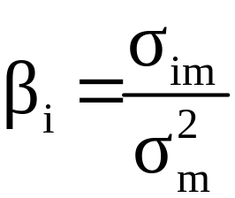
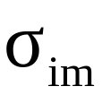

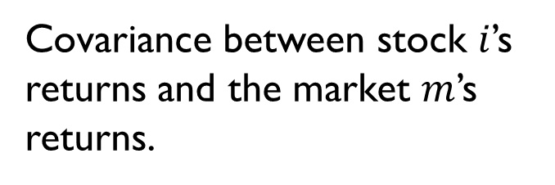
Market Risk Is Measured by Beta
Beta: Sensitivity of a stock’s (stock $i$) return to the return on the market portfolio.
  Covariance between stock $i$’s returns and the market $m$’s returns.
Variance of the returns on the market.

Slide 46
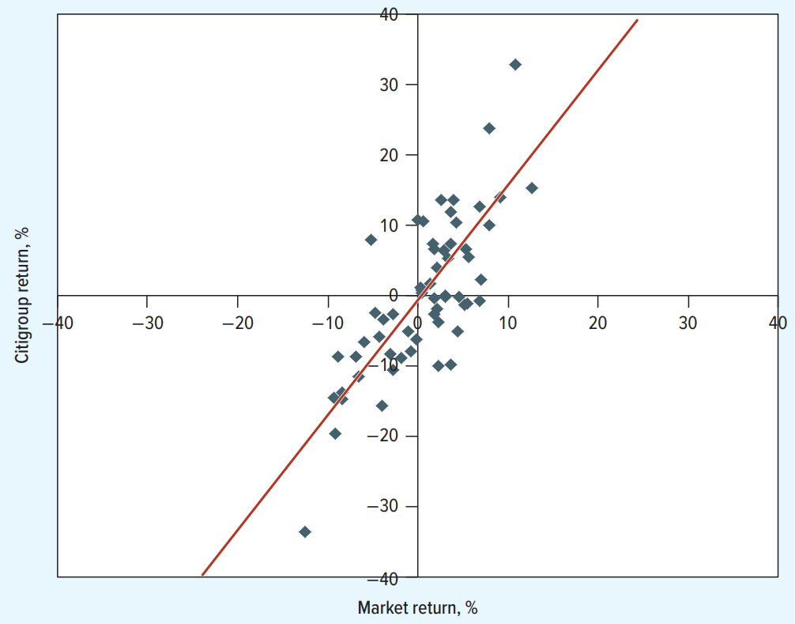
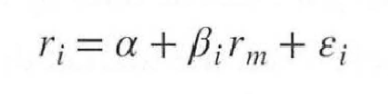
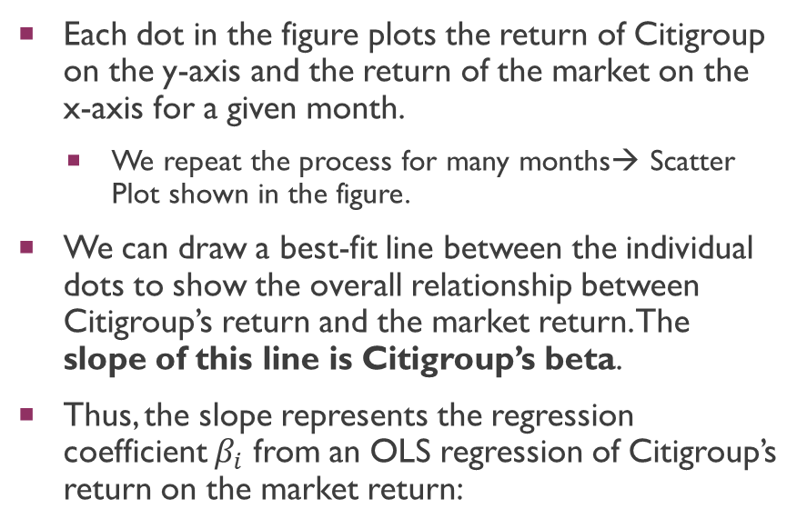
Estimating beta
Each dot in the figure plots the return of Citigroup on the y-axis and the return of the market on the x-axis for a given month.
  We repeat the process for many months→ Scatter Plot shown in the figure.
We can draw a best-fit line between the individual dots to show the overall relationship between Citigroup’s return and the market return. The slope of this line is Citigroup’s beta.
Thus, the slope represents the regression coefficient $β_{i}$ from an OLS regression of Citigroup’s return on the market return:

Slide 47
Estimating beta
In this figure, Beta is estimated at 1.56.
  The return on Citigroup stock changes on average by 1.56% for each additional 1% change in the market return.
Intuition behind Beta: It measures the sensitivity of the stock with respect to the market.
If the future resembles the past, then when the market rises an extra 1%, Citigroup's stock price will rise by an extra 1.56% on average.
  When the market falls an extra 2%, Citigroup's stock price will fall on average by an extra 2 X 1.56 = 3.12%.
Since beta represents undiversifiable risk, the beta of a portfolio is simply the weighted average of the betas of the stocks in that portfolio.

Slide 48
What determines beta?
A stock’s beta is primarily driven by business risk, measuring how heavily the company's underlying revenue depends on the broader economic cycle.
Luxury manufacturers like Porsche typically exhibit betas greater than 1, as discretionary spending on high-end goods fluctuates aggressively with market booms and busts.
Companies providing essential services, such as energy companies, generally have betas between 0 and 1 because demand for necessities like electricity remains stable regardless of economic conditions.
True negative beta assets are exceptionally rare in public markets, as even counter-cyclical businesses like insolvency practices are usually part of larger, diversified firms that still correlate with the overall economy.

Slide 49
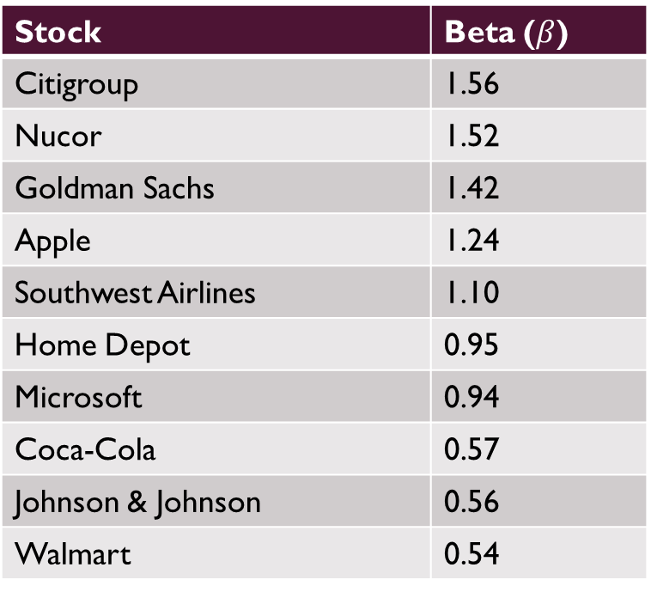
CAPM, Betas, and expected returns
Stock | Beta ($β$)
Citigroup | 1.56
Nucor | 1.52
Goldman Sachs | 1.42
Apple | 1.24
Southwest Airlines | 1.10
Home Depot | 0.95
Microsoft | 0.94
Coca-Cola | 0.57
Johnson & Johnson | 0.56
Walmart | 0.54

Slide 50
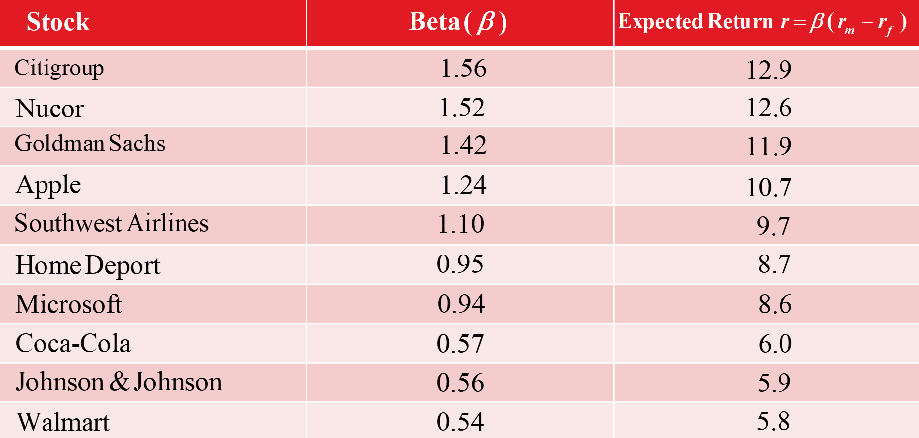
CAPM, Betas, and expected returns
Notice that “high beta” stocks are associated with high expected returns. Why?
NB: The textbook assumes $r_{f}$ = 2% and $r_{m}–r_{f}$ = 7%.

Slide 51
CAPM, Betas, and expected returns
We discuss the intuition behind this r/s before deriving the mathematical formula for the CAPM model.
Investors require compensation in the form of higher expected returns for bearing systematic risk, which is the specific type of market-wide volatility that cannot be eliminated through diversification.
High beta stocks are structurally unattractive because they tend to suffer the steepest losses during economic downturns, destroying wealth exactly when investors are most financially vulnerable and value their capital the most.
Because these assets tend to magnify financial distress by crashing exactly when the economy falters, investors demand a lower purchase price—and thus a higher expected return—to compensate for the risk of losing wealth precisely when they need it most.
The CAPM (Capital Asset Pricing Model) relates the expected return of an asset to its systematic risk, measured by beta.

Slide 52
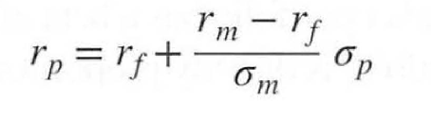

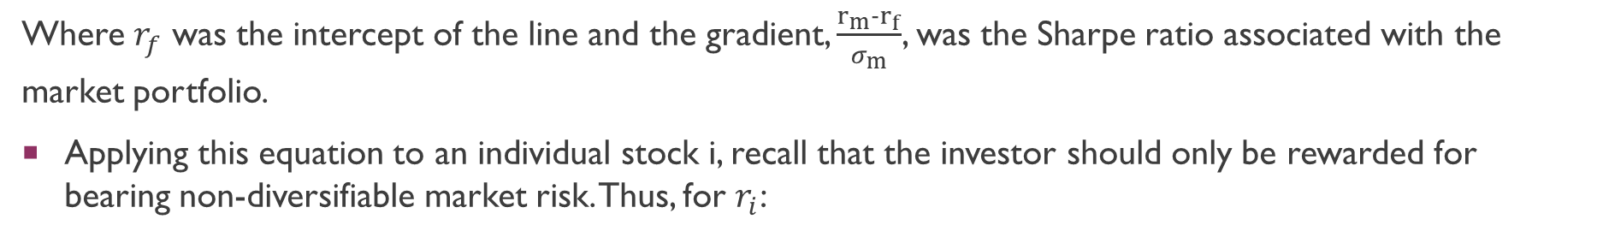
CAPM, Betas, and expected returns
How much extra return should an investor expect for bearing market risk?
Recall the equation of the capital market line:
Where $r_{f}$ was the intercept of the line and the gradient, $\frac{r_{m}−r_{f}}{σ_{m}}$, was the Sharpe ratio associated with the market portfolio.
Applying this equation to an individual stock i, recall that the investor should only be rewarded for bearing non-diversifiable market risk. Thus, for $r_{i}$:

Slide 53
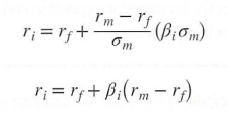

CAPM, Betas, and expected returns
However, we know that the market risk of stock $i$ is simply $β_{i}σ_{m}$. Thus,
Rearranging, we get the CAPM equation: The expected risk premium on a stock (LHS) is its beta multiplied by the expected risk premium on the market (RHS).

Slide 54
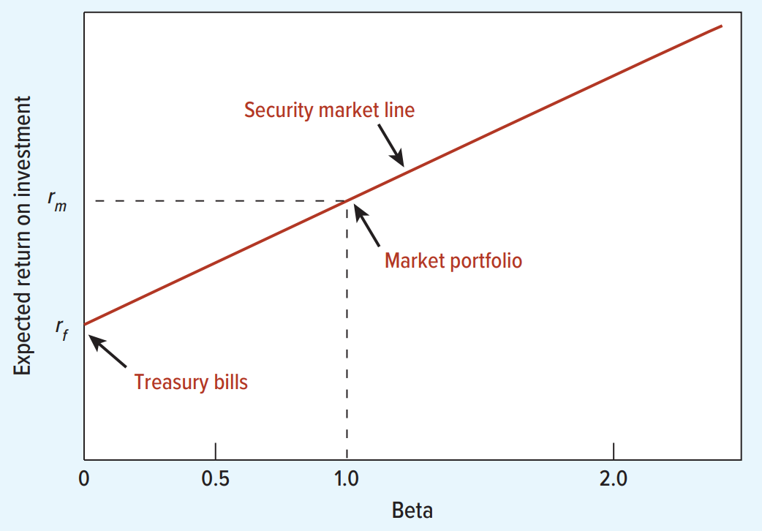
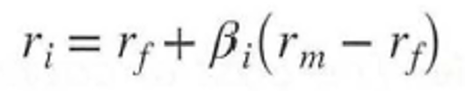
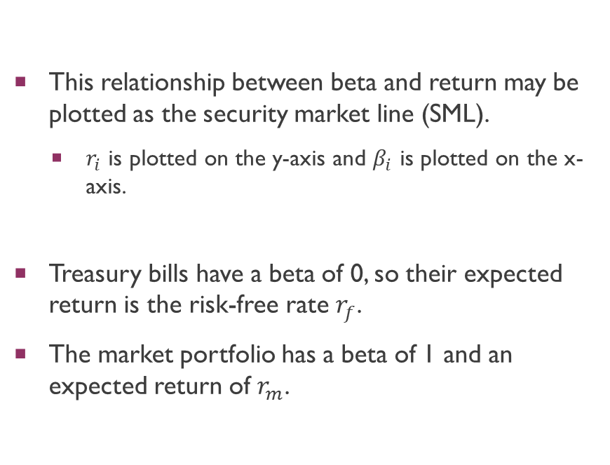
CAPM, Betas, and expected returns
This relationship between beta and return may be plotted as the security market line (SML).
  $r_{i}$ is plotted on the y-axis and $β_{i}$ is plotted on the x-axis.
Treasury bills have a beta of 0, so their expected return is the risk-free rate $r_{f}$.
The market portfolio has a beta of 1 and an expected return of $r_{m}$.

Slide 55
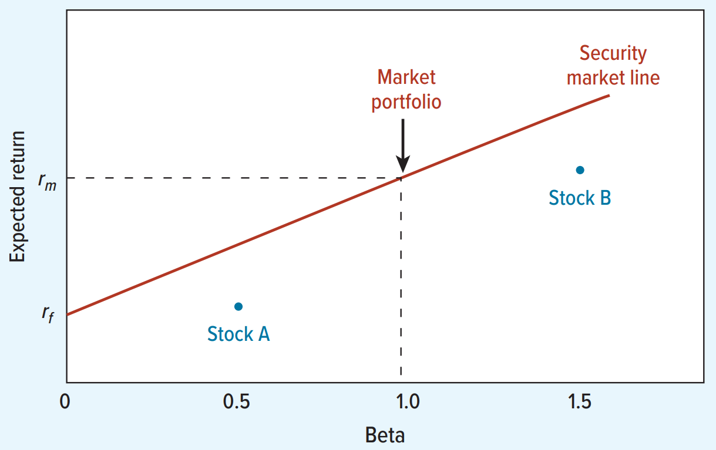
CAPM, Betas, and expected returns
In equilibrium, no stock lies below the security market line.
Instead of buying Stock A, investors lend part of their money and put the balance in the market portfolio.
  Suppose not. Then you could get a higher expected return for the same risk (beta) by being on the security market line, investing half your money in Treasury bills and half in the market portfolio.
Instead of buying Stock B, they borrow and invest in the market portfolio.
  Suppose not. Then you could get a higher expected return for the same risk (beta) by being on the SML, borrowing half your initial wealth and investing 1.5 times your wealth in the market portfolio.

Slide 56
CAPM, Betas, and expected returns
Are there stocks that offer a higher expected risk premium and therefore lie above the security market line?
  Suppose there were. Those stocks would offer a higher return than other stocks of the same systematic risk. Investors would pile into them, pushing their prices up and their expected returns down, until they lay on the security market line and offered the appropriate return for their beta.

Slide 57
Does capm hold in the real world?
The CAPM makes several assumptions, some of which may not hold in the real world.
Investors choose portfolios based on expected return and variance (risk).
All investors have the same estimates of mean returns, variances, and covariances.
Investors trade in perfect capital markets.
  There are no frictions such as taxes, transaction costs, or restrictions on short sales. Investors can both borrow and lend at the same risk-free rate.
Investors are price takers and cannot influence prices.
The supply of all assets is fixed.

Slide 58
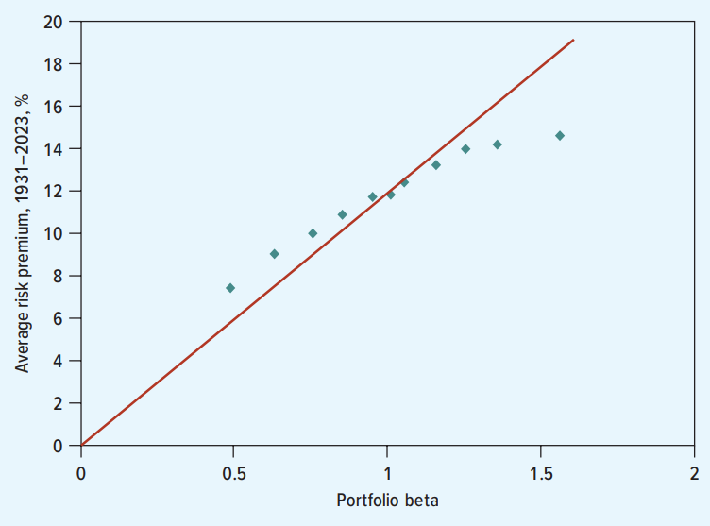
Does capm hold in the real world?
Actual Relationship between Beta and Returns (1931-2023)
Source: F. Black, “Beta and Return,” Journal of Portfolio Management 20 (1993), pp. 8 to 18. Updates courtesy of Adam Kolasinski.
Notes:
Over a 93 year period, returns did increase with beta.
However, Portfolio 1 should have provided a risk premium of 0.49 x 11.7% = 5.7%. Instead, it earned a higher risk premium of 7.4%.
Portfolio 10 should have provided a risk premium of 1.56 x 11.7% = 18.3%. Instead, it earned a lower risk premium of 14.6%.

Slide 59
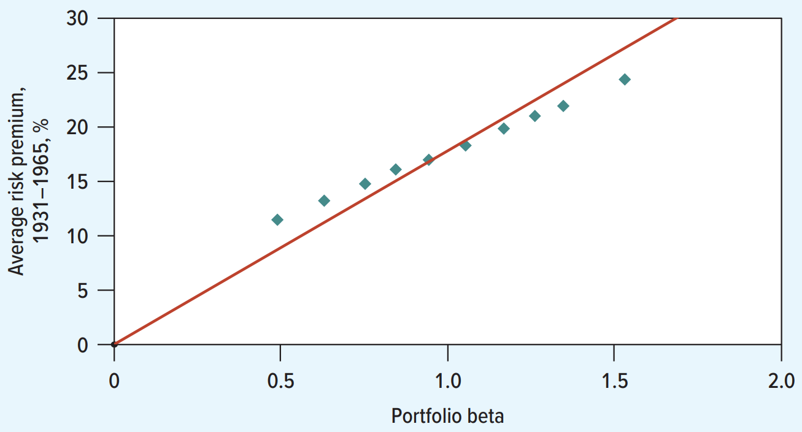
Does capm hold in the real world?
Actual Relationship between Beta and Returns (1931-1965)
Source: F. Black, “Beta and Return,” Journal of Portfolio Management 20 (1993), pp. 8 to 18. Updates courtesy of Adam Kolasinski.
Notes:
Line has become progressively “flatter” over the years.

Slide 60

Does capm hold in the real world?
Actual Relationship between Beta and Returns (1966-2023)
Source: F. Black, “Beta and Return,” Journal of Portfolio Management 20 (1993), pp. 8 to 18. Updates courtesy of Adam Kolasinski.
Notes:
Line has become progressively “flatter” over the years.

Slide 61

Does capm hold in the real world?
Standard CAPM assumes all investors borrow and lend at the risk-free rate ($r_{f}$), but in reality, the borrowing rate ($r_{B}$) is significantly higher, creating a friction that splits the efficient frontier.
Savers, or “Chickens,” face the lower risk-free rate ($r_{f}$) and optimize their trade-off relative to Tangency Portfolio $T_{S}$. They construct their final portfolio $C_{T_{S}}$ by holding a mix of risk-free bills and the stock portfolio $T_{S}$.
Borrowers, or “Lions,” face the higher borrowing cost ($r_{B}$) and must optimize relative to a different Tangency Portfolio $T_{B}$. They achieve their desired high returns by borrowing money to invest more than 100% of their wealth into portfolio $T_{B}$, resulting in the leveraged position $L_{T_{B}}$.
Consequently, there is no single “Market Portfolio” held by everyone; instead, the aggregate market is a weighted combination of the saver’s portfolio ($T_{S}$) and the borrower’s portfolio ($T_{B}$), connected by a curve rather than a single straight line.

Slide 62
Does capm hold in the real world?
Because average investors cannot borrow cheaply to leverage safe assets, they are forced to buy inherently high-beta stocks to achieve high nominal returns, driving up the prices of these risky assets.
This excessive demand causes high-beta stocks to become overpriced, leading them to deliver lower future returns than standard CAPM predicts (a flattening of the Security Market Line).
Conversely, low-beta stocks become undervalued, offering superior risk-adjusted returns because they are ignored by aggressive investors who cannot apply leverage.
Sophisticated investors with access to low-cost borrowing (such as Warren Buffett) exploit this inefficiency by purchasing these undervalued low-beta stocks and leveraging them up, rather than overpaying for high-beta stocks.

Slide 63

Does capm hold in the real world?
The CAPM with Different Borrowing and Lending Rates
Notes:
Line has become progressively “flatter” over the years.

Slide 64
Does capm hold in the real world?
Furthermore, contrary to CAPM, market data indicates that stock returns are not solely driven by systematic risk, but are also significantly correlated with specific firm characteristics such as market capitalization.
The historical performance spread demonstrates that while small-cap stocks experience periods of underperformance, they have generated significantly higher cumulative returns than large-cap stocks over the long term.
Since the end of 1926, this “size effect” has resulted in small stocks outperforming large stocks by an average annual margin of 2.9%, rewarding investors for holding smaller companies.
However, this long-standing trend has notably reversed from 2022 through 2025, as the artificial intelligence revolution catalyzed a massive divergence where mega-cap technology stocks significantly outperformed their smaller counterparts.

Slide 65

Does capm hold in the real world?
Small Stock and Value Premiums
Notes:
Green line: value – growth
Red line: Small – big.

Slide 66

Does capm hold in the real world?
Small Stock and Value Premiums
Notes:
Line has become progressively “flatter” over the years.

Slide 67

Does capm hold in the real world?
Notes:
Line has become progressively “flatter” over the years.

Slide 68
Arbitrage pricing theory and factor models
Unlike the Capital Asset Pricing Model, which assumes market risk is the sole driver of returns, Arbitrage Pricing Theory (APT) offers a more flexible alternative by positing that a stock's expected return is determined by its sensitivity to multiple pervasive macroeconomic factors.
Under this framework, risk premiums are built up from various systemic drivers—such as unexpected changes in inflation, interest rates, or energy prices—where each asset has a unique sensitivity (beta) to each specific factor.
The model relies on the principle of no-arbitrage, arguing that if a diversified portfolio offers a return inconsistent with its aggregate risk exposure, investors would exploit the mispricing to generate risk-free profits until the equilibrium relationship is restored.
A major limitation of APT is that it does not theoretically identify exactly what these factors are, prompting researchers to empirically search for specific portfolio characteristics (such as firm size and book-to-market ratios) that better explain returns, a pursuit that directly established the Fama-French Three-Factor Model.
Notes:
NB: APT models are thus termed “factor models” in Finance.

Slide 69
Arbitrage pricing theory and factor models
An Alternative to CAPM
Notes:
NB: APT models are thus termed “factor models” in Finance.

Slide 70

Arbitrage pricing theory and factor models
Steps to Identify Factors.
Identify a reasonably short list of macroeconomic factors that could affect stock returns.
Estimate the expected risk premium on each of these factors ($r_{factor1}$-$r_{f}$), etc.
Measure the sensitivity of each stock to the factors ($b_{1}$, $b_{2}$, etc.)
See https://papers.ssrn.com/sol3/papers.cfm?abstract_id=5318203, Section 8.2 (pp. 62 to 65)
Notes:
NB: APT models are thus termed “factor models” in Finance.

Slide 71
Arbitrage pricing theory and factor models
Factor | Measured by
Market factor (MKT) | Return on market index minus risk-free interest rate
Size factor (SMB) | Return on small-firm stocks minus return on large-firm stocks
Book-to-market factor (HML) | Return on high book-to-market-ratio stocks minus return on low book-to-market-ratio stocks (i.e., return of value stocks minus the return of growth stocks)
Notes:
NB: APT models are thus termed “factor models” in Finance.
If a company has High Book Value (lots of factories, inventory, cash) but a Low Market Price, the ratio is high. If a company has Low Book Value but a High Market Price (like a tech startup with few assets but a huge stock price), the ratio is low.

Slide 72
Arbitrage pricing theory and factor models
FF-Three-Factor Model C A P M
 | b _{market} | b _{size} | b _{book-to-market} | Expected Return ª | Expected Return ^{b}
Autos | 1.72 | 0.92 | −0.44 | 14.7% | 15.1%
Banks | 1.07 | 0.25 | 0.65 | 13.1 | 9.8
Chemicals | 1.09 | 0.04 | 0.39 | 11.4 | 9.7
Computers | 1.00 | 1.01 | 0.04 | 9.2 | 9.0
Construction | 1.29 | −0.04 | 0.22 | 11.9 | 11.0
Food | 0.58 | −0.34 | 0.22 | 6.1 | 5.7
Oil and gas | 1.24 | 0.51 | 1.27 | 17.7 | 11.4
Pharmaceuticals | 0.58 | −0.03 | −0.12 | 5.4 | 6.0
Telecoms | 0.82 | −0.01 | 0.19 | 8.6 | 7.8
Utilities | 0.64 | −0.51 | 0.17 | 5.7 | 5.9
Notes:
NB: APT models are thus termed “factor models” in Finance.

Slide 73

Arbitrage pricing theory and factor models (optional)
Notes:
NB: APT models are thus termed “factor models” in Finance.

Slide 74

Arbitrage pricing theory and factor models
VTI (“Market” Index ETF)—Teal Line (53.21% 5Y); DFUS (Factor-oriented ETF)—Blue (64.70% 5Y) Line
Notes:
NB: This is a returns chart over time. DFUS often beats VTI isn't just because it buys "Small" stocks; but rather because it avoids "Bad" Small stocks.

Slide 75
Q&A
See you guys on Thurs.

